Slide 1

Flight Delay Prediction
Team 7
Sheng(Johnny) Zhou, Tzu Ching(Charlie) Chou, Zheman(Mia) Zhong, Guang(Jacky) Yang

Slide 2
Colab Link:
https://drive.google.com/file/d/1Lx5kEaRpVgl-jvYOngLmonZPsGbpyv-o/view?usp=sharing
Team 7
Sheng(Johnny) Zhou, Tzu Ching(Charlie) Chou, Zheman(Mia) Zhong, Guang(Jacky) Yang

Slide 3
Table of contents
01
04
02
02
05
03
02
Problem
ML Models
Problem Statement
Model Development
(Decision Tree, Random Forest, KNN, SVC, Logistic Regression, XGBoost)
Model Evaluation
DATASET
Data Overview
Features Correlation
Conclusion
EDA
Data Visualization
Notes:
Our presentation today can be divided into 5 parts.
First, we will go to the problems statement
Then, i will introduce our dataset briefly
After that, we will move to Exploratory data analysis to show the data visualization
Then, we will talk about the ML models, including model development and model evaluation
Last, we will go to the conclusion.

Slide 4

Part 1: Problem
Notes:
Mia

Slide 5
1
Problem Statement
Why is it important?
Flight delays have become an important subject and problem for air transportation systems all over the world.
The aviation industry is continuing to suffer from economic losses.
More than 20% of U.S. flights were delayed in 2018 (Bureau of Transportation Statistics,BTS)
More than 40 billions dollars per year
Passengers:
Loss of time, missed business opportunities, missed leisure activities…
Other adverse impact:
Environment (extra fuel consumption and a larger adverse environmental impact).
Notes:
Our main target in the project is to make a prediction of flight delay, which is a really important problem that we face all over the world today.
The aviation industry is continuing to suffer from economic losses associated with flight delays all the time.
According to data from the Bureau of Transportation Statistics (BTS) of the United States, more than 20% of U.S. flights were delayed in 2018.
These flight delays have a severe economic impact in the U.S. that is equivalent to 40.7 billion dollars per year.
Apart from that, Passengers suffer a loss of time, missed business opportunities or leisure activities,
Besides, Airline delay also leads to extra fuel consumption and a large adverse environmental impact.
In order to alleviate the negative impacts caused by unexpected flight delays, an accurate prediction of flight delays in is needed.

Slide 6
Part 2: DataSet
Notes:
Mia

Slide 7
2.1
Data Source
Source: Kaggle:Airlines Dataset to predict a delay—539383 instances and 8 different features
Features:
Airline: Different commercial airline companies
Flight: Types of Aircraft
AirportFrom: Departure Airport
AirportTo: Destination Airport
DayofWeek: The Day of Week
Time: Departure time measured in minutes from midnight (range: 10 - 1439)
Length: Duration of the flight in minutes
Delay: Whether the flight is delayed or not(0 or 1)
Notes:
We find our dataset from kaggle, which includes 8 features and More than 5 hundred thousands instances
It is worth to Notice that:
Time: Departure time measured in minutes from midnight (range: 10 - 1439)
10: 10 past midnight
1439: 11:59 at the end of the day

Slide 8
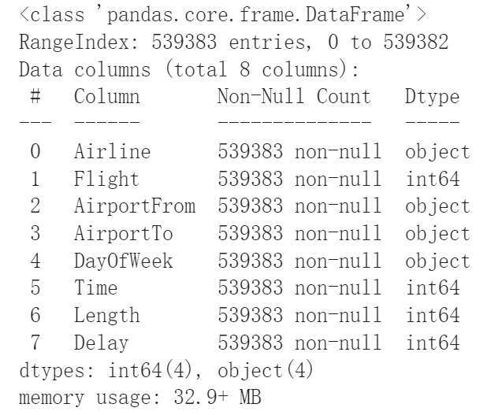
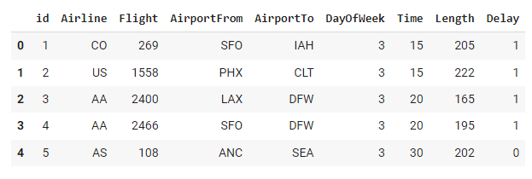
2.2
Glimpse of our dataset
Binary: Delay (Target)
Categorical: Airline, AirportFrom, AirportTo, DayofWeek
Numerical: Time, Length, Flight
Notes:
There is no missing value in our dataset
The left table shows part of our original data
We dropped the column ‘id’ at first and kept other 8 features for later analysis
Target variable is Delay ( binary)
4 categorical variables
3 numerical variables
The reason we treat Flight as numerical variable is that it contains too many unique values and when we train ML models later, it would be efficient to keep it numerical

Slide 9
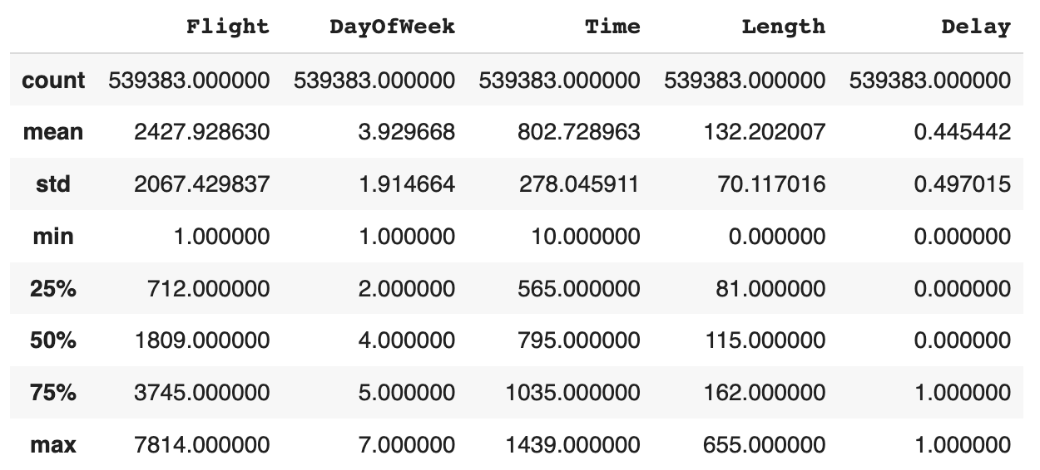
2.3
Data Description
Task: Predict whether a given flight will be delayed, given the information of the scheduled departure.
Notes:
Time:
Min of time: 10 Max of time: 1439
The departure time of flights in this dataset is ranging from 00:10 to 23:59
More than 50% flights depart after 9 am and before 6:00 pm.
Length:
Min of length: 0 —maybe outliers
The average length of flights is 132 minutes
75% flights are not long flying-trips, length of them are less than 162 minutes(2.7 hours).

Slide 10
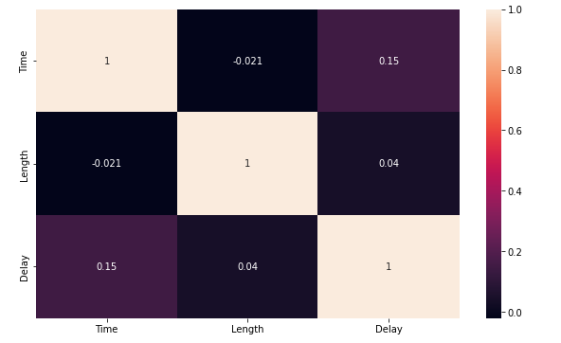
2.4
Correlation
Notes:
Mia
In order to find the correlation of delay between different features we made a heatmap of correlation.
We find out departure time of flight have larger Corr with Delay .

Slide 11
Part 3:
EDA
Notes:
Charlie

Slide 12
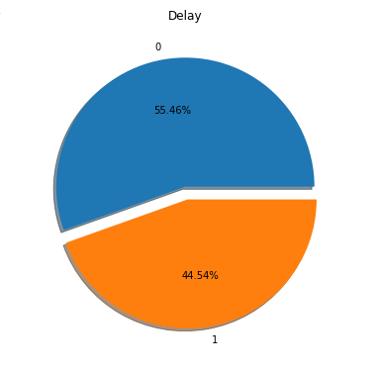
Target Variable Distribution
3.1
Basically Balanced
Delay(1) : 44.54%
Not delay(0) : 55.46%
Notes:
Charlie
We have a relatively balanced target variable

Slide 13
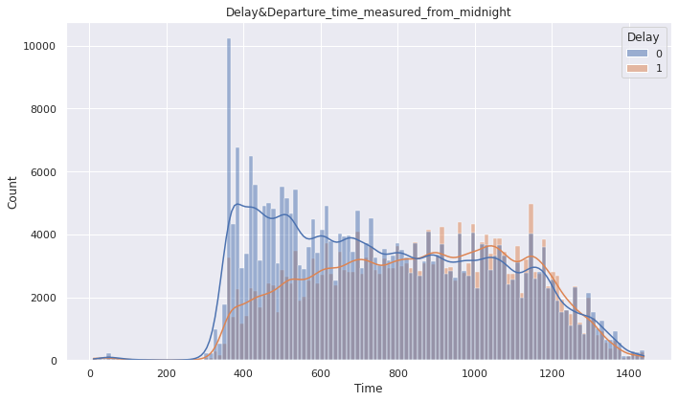
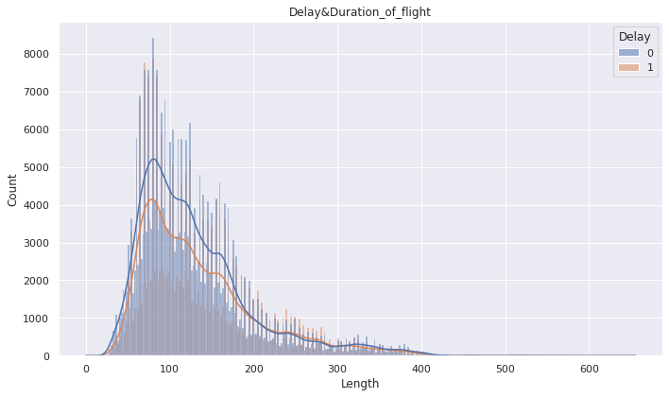
3.2
Numerical Variables
Delay & Duration of flight
Delay & Departure time measured from midnight
Notes:
Charlie :the blue line stand for airplane is not delay, and orange line means delay
Time: departure time measured in minutes from midnight (in fact the range is 10-1439); (凌晨机场不忙 所以delay的少)---we have really interesting finding, there are less delay flight after midnight and numbers of delay flights increase dramatically around 6 am. 这里可以强调一下左边这个图 可以去看蓝色bar和橙色bar的差 差越大代表delay ratio越小 越不容易delay, We thought the reason is the airports are not busy at midnight, there are more parking space for airplane land off.
Length: duration of the flight in minutes (从200分钟开始 delay 跟不delay开始贴合， 也就是说在200分钟之前飞机更容易不delay) We find out the line of Delay or not fit perfectly before the duration of flight in 200 min. We thought the reason is maybe short trip have less possibility to delay..

Slide 14
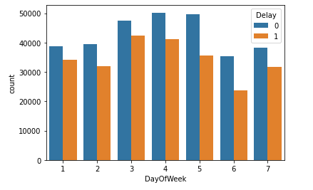
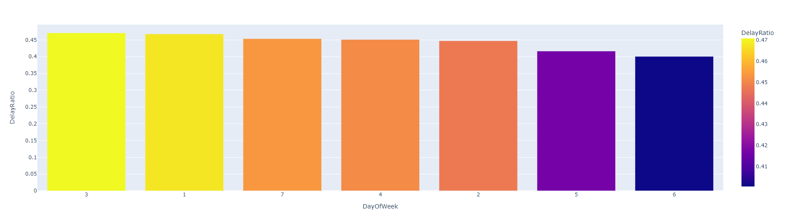
Categorical Variables
3.2
Delay count & Day of Week
Delay Ratio & Day of Week
Wednesday, Thursday and Friday have most flights and most delayed
Less probability of delayed flight on Friday and Saturday
Notes:
Charlie

Slide 15
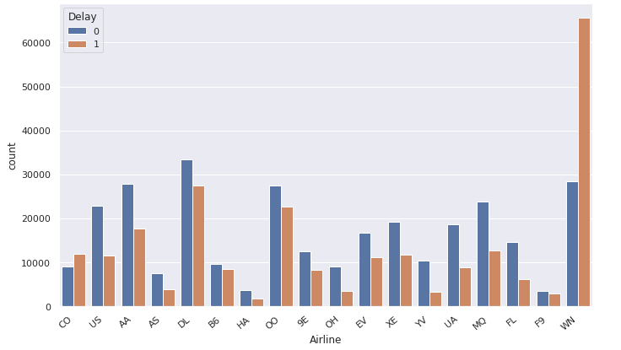
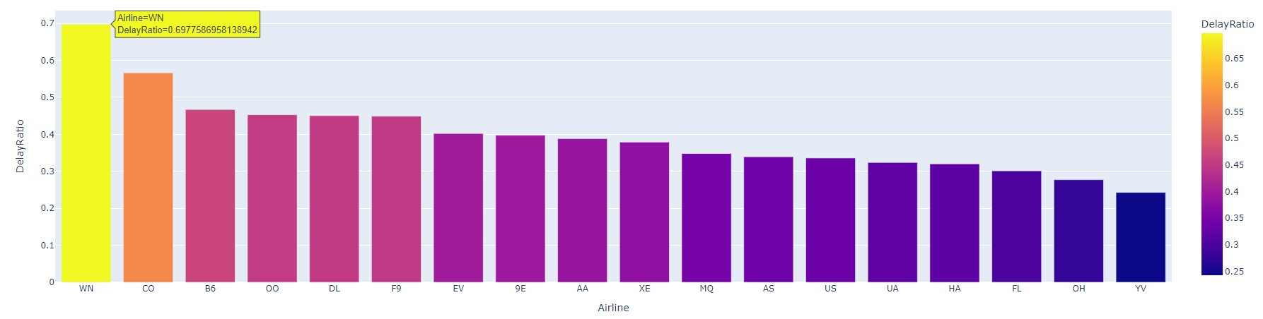
Categorical Variables
3.2
Delay count & Airline
WN(SouthWest) has the most flights of delay and the highest Delay ratio
CO(Continental) has the second highest Delay ratio, but has fewer flights
Delay Ratio & Airline
Notes:
Johnny
we want to find the relation between delay and each airline
The plots present that the Airline WN has the most flights of delay, which is more than 65000 in total, and its delay ratio is also the highest ( around 70% flights in WN could be delayed). Another airline that has more than half of the flights that could be delayed is Airline CO, which, however, has much less flights in total than most other airlines. And it was merged with United Airline in 2010s.
While the delay ratio of airlines YV, OH and FL are the lowest, around only 25% to 30% flights could be delayed respectively. So, for individuals, choosing these airlines could be a better choice, however these are small and regional airlines that has a lot less flights and routes , and for airline companies), southwest airline and should improve their operations and procedures for keeping more flights on time.

Slide 16
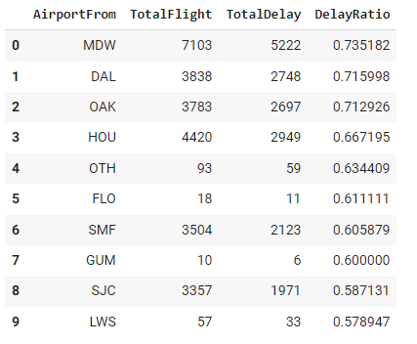
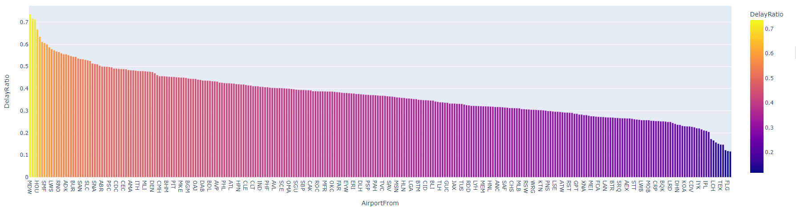
Categorical Variables
3.2
MDW(Chicago Midway International Airport) has the most flights and the highest Delay Ratio
DAL(Dallas Love Field Airport) comes in second
OAK(Oakland International Airport) comes in third
Delay Ratio & AirportFrom
Notes:
Johnny
The flights departing from the airport MDW, DAL and OAK reach the highest delay ratio level, these three airports have more than 70% of the flights delayed. As u you can see these are very large international airport in large cities and handle huge volumes everyday, always busy,
The flights which depart from airports that have low delay ratio which are show at the end of this chart, are more likely to be on time, less than 13% of flights departing from these airports are delayed. however, these airports are relatively small airports and usually do not have tons of flights and available routes.

Slide 17
Part 4:
ML Models
Notes:
Johnny

Slide 18
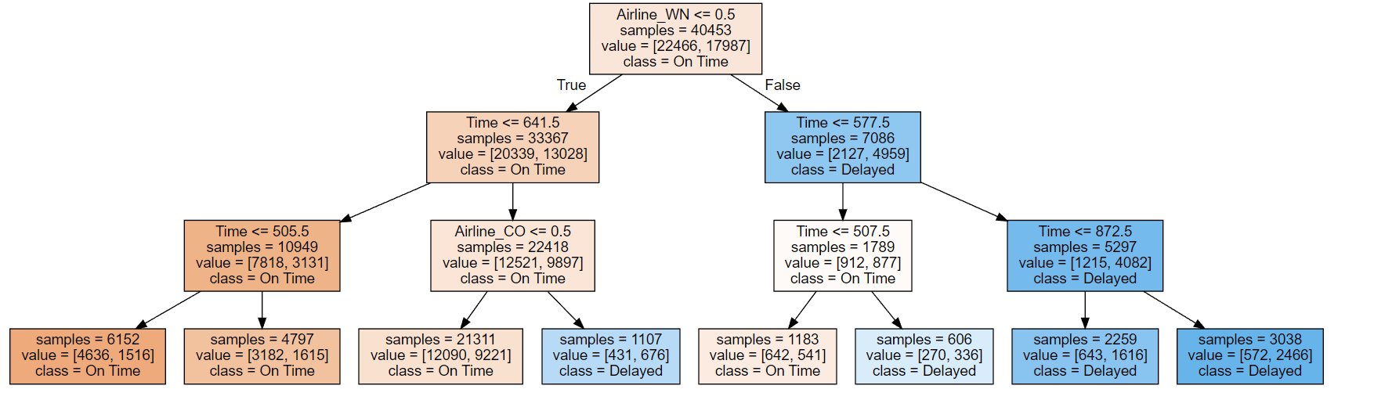
DecisionTreeClassifier
Notes:
Johnny
We first try to use the DT classifier, because it can handle categorical variables and missing values and it does not require a pipeline. And it is also great for interpreting if we generate a graph like this.
According to the decision tree graph, the orange means on time and the blue means delayed.
if the passenger does not wish their flight to be delayed, it would be best for them to avoid “Airline_WN”(SouthWest AL), and if the flight departs before 10:40am(641.6 mins), it is more likely that the flight will be on time, Moreover, if the flight departs even earlier before 8:25am(505.5 mins), it will further increase the chance of the flight will be on time. Last but not least, it would also wise to avoid CO(Continental airline).

Slide 19
Pipeline
Pipeline
Numerical Features
Categorical Features
Simple Imputer
（median）
StandardScaler
Simple Imputer
(Most Frequent)
OneHotEncoder
Notes:
Jacky

Slide 20
Model Selection
XGBoost
Log Regression
Random Forest
KNN
SVC
Decision Tree
Notes:
Jacky

Slide 21
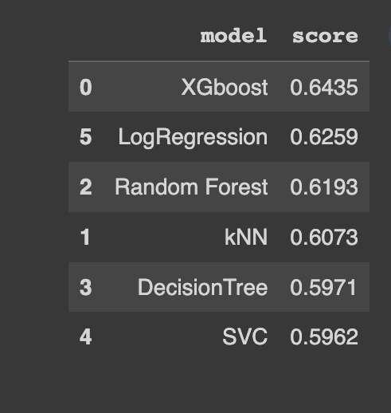
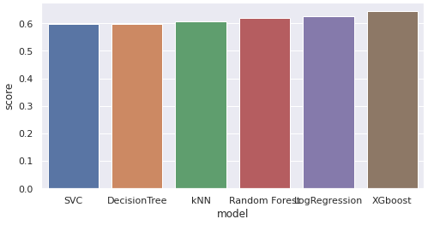
Evaluation
Notes:
Jacky
For DecisiontreeClassifier, we did not prune the tree, so the score might be low,

Slide 22
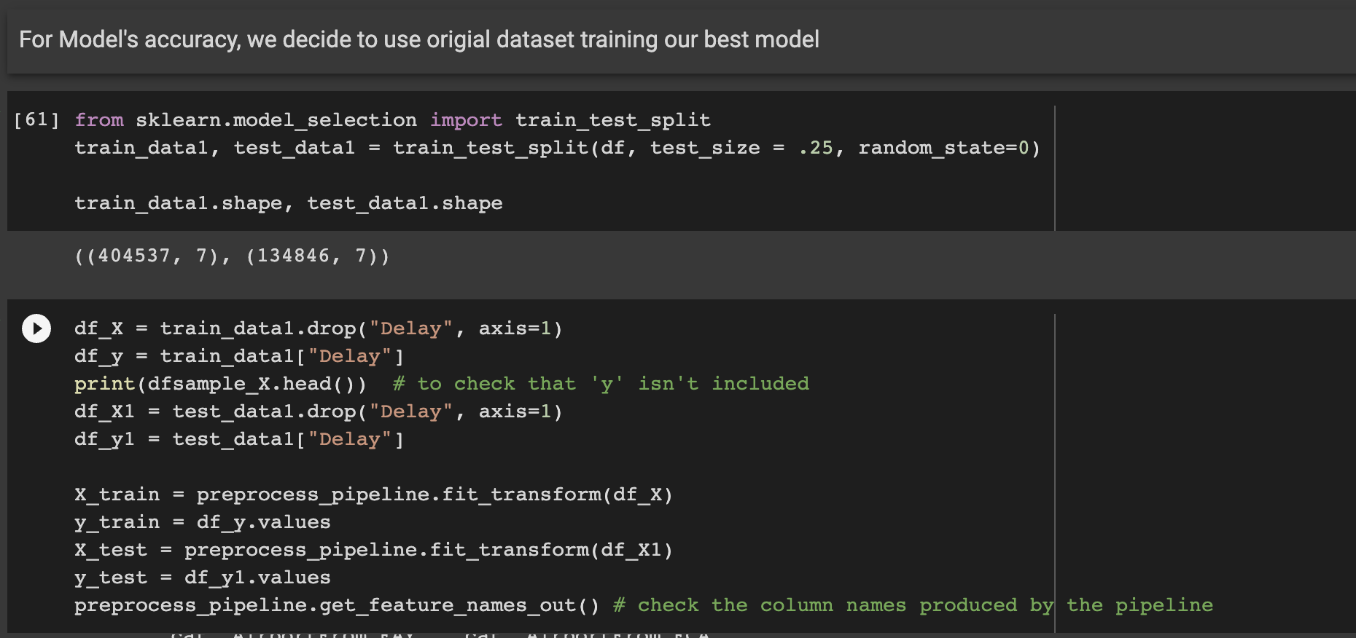
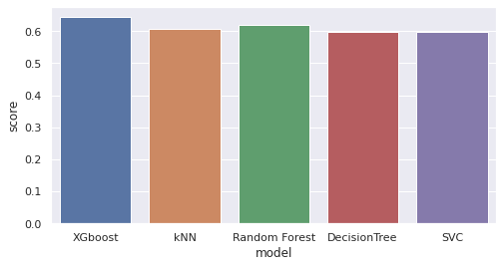
XGBoost Tuning
Notes:
Jacky

Slide 23
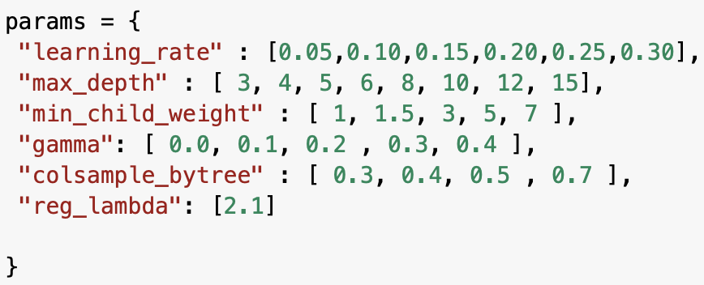

XGBoost Tuning
Notes:
Jacky

Slide 24
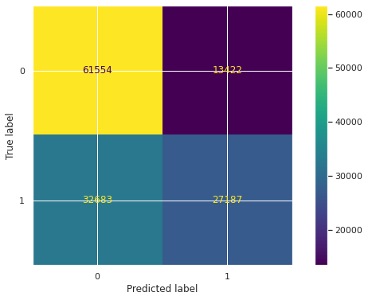
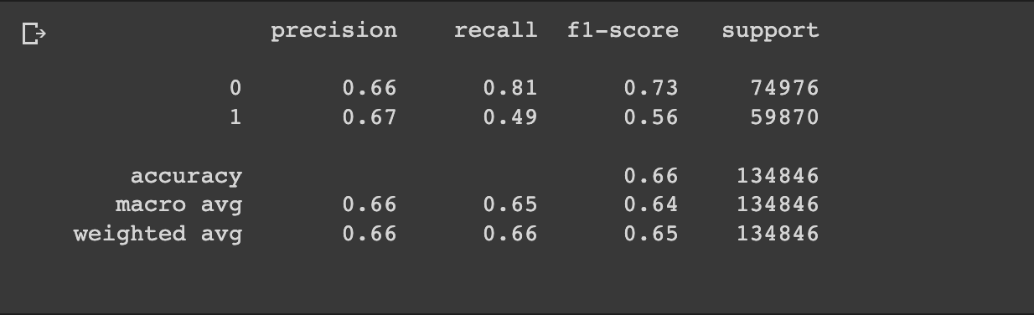
Model Evaluation
Notes:
Charlie

Slide 25
Part 5:
Conclusion
Notes:
Charlie

Slide 26
Conclusion
Insights
Challenges
Long computational time
Friday and Saturday have least delays
SouthWest Airline has the highest delay ratio
Depart before 10 am
YV,OH,FL Airlines have lowest
XGBoost
Notes:
Charlie

Slide 27
Q&A

